Slide 1
FIRST DELIVERY
01
HCI PROJECT
Fernando Rodríguez, Rodrigo Euan, Guillermo Medina, Ricardo Kú

Slide 2
TABLE OF CONTENTS
01
03
02
04
Project Definition
Project Timeline
A brief definition of the project
Activities scheduled in sprints
Justification of the Project
Research Plan
Investigation Details and Planification
How our application solves a problem

Slide 3
TABLE OF CONTENTS
05
07
06
08
Personas
Our Team
Samples of personas we’ve focused on
How our team is integrated
Metrics
Credits
We show the way we are measuring and evaluating members contribution
Acknowledgements

Slide 4
Project Definition
01

Slide 5
Project
Definition
The main goal of this HCI project is to:
Provide an easy way to organize materials, activities, exams in one platform.
Notify the students when a new assign is on the platform
And the most important thing: We want to unify every material from the different assignment we have on the semester

Slide 6
Justification of the application
02

Slide 7
Justification of the application
Remote Class
Material not unified
Nowadays we have every class online
Every profesor use a different platform for distintal purpose
Many students work while are studying
Some platforms don't notify
There are no notification unless you enter the site

Slide 8
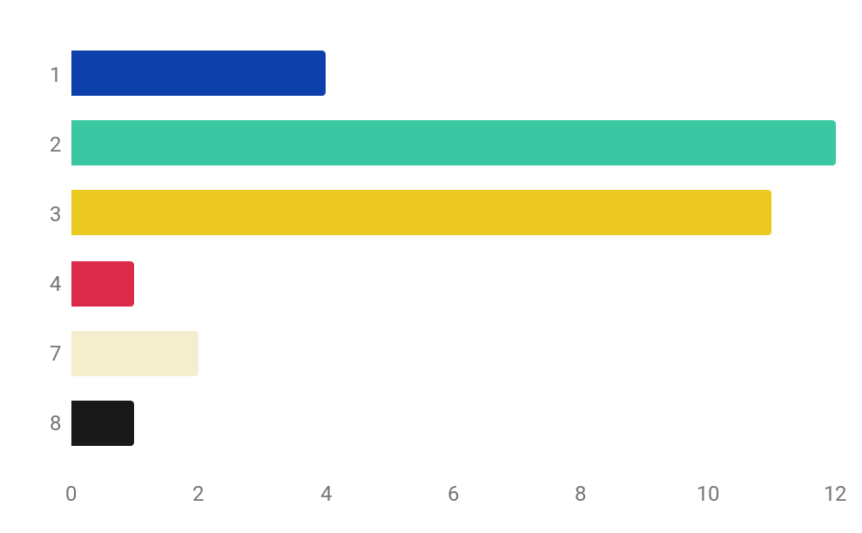

Student Results
1
Yes
2
Student that work
3
54.8%
4
45.2%
7
No
8
Only study
This graph show how many platforms students have to check for this semester
*This research was done only for 31 Students
This graph show how many students works and study at the same time.
*This research was done only for 31 Students

Slide 9
Project Timeline
03

Slide 10
TIMELINE
* Each sprint lasts between one or two weeks
01
02
03
04
Reqs. Determination
Context Analysis
Task Analysis
Evaluation Metrics
To determine the likelihood of target users’ accepting a system’s functionalities, user needs.
Understanding the technical, environmental and social settings where the information systems will be used.
Understanding what people do to achieve their goals.
Evaluation metrics specify the expected goals of human system interaction for the designed system.

Slide 11
Research Plan
04

Slide 12
RESEARCH PLANS
Survey Student
Survey Teachers
Card Sorting
Make 2 surveys to know our Personas and User needs
Make 2 surveys to know our Personas and User needs
Discover how users believe content should be organized
Context Analysis
User Analysis
Task Analysis
Understanding the technical, environmental and social settings where the information systems will be used.
Identifies the target users and their characteristics including
Understanding what people do to achieve their goals

Slide 13
Personas
05

Slide 14

Persona
Back Story: Full-time student and part-time employee, working for a living and focusing on her studies in her free time. Usually in a 6-8 hour shift that makes it difficult to connect to her online courses.
Has good motivation but a lack of options to continue her studies at a regular pace.
Goals:
Reduce the impact of academic dynamics on her education.
Been able to know when a new activity is set on the platform(s)
Persona Information
Name: Maria Ponce
Age: 18 - 25
Occupancy: Student
Location: Mérida, Yucatán
Description: University student studying by remote mode during the pandemic
Frustrations:
Have poor time she doesn’t attend to much because she needs to work in class hours
Many tools she needs to be aware of how to achieve her homeworks and activities.

Slide 15
Metrics
06

Slide 16
METRICS
Classes | Equivalents | Score(hrs)
B | B | 1
M | BB | 2
A | MM | MBB | BBBB | 4

Slide 17

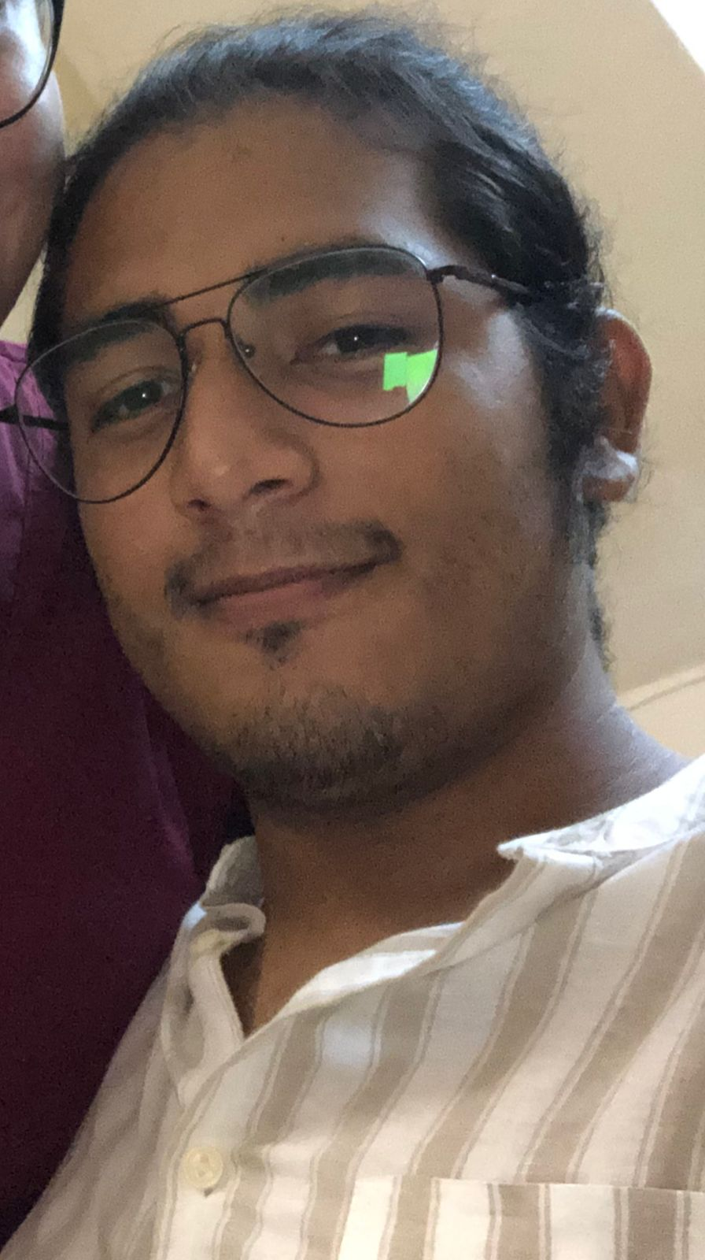

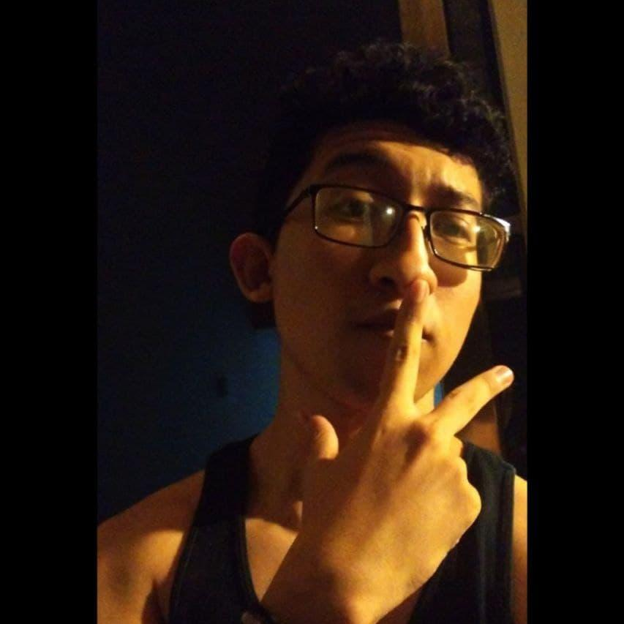
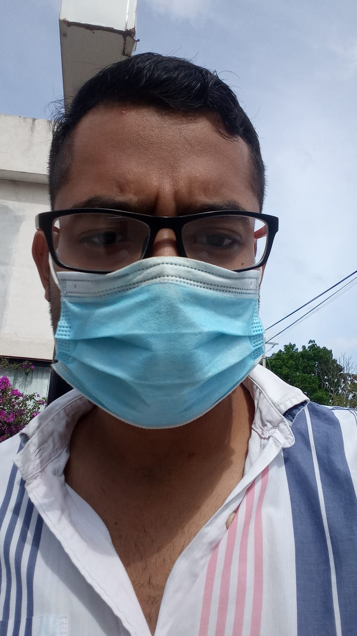

OUR TEAM
07
Ricardo Kú
Rodrigo Euan
Juan Fernando
Guillermo Medina

Slide 18
THANKS
08
Do you have any questions?
Please keep this slide for attribution

